Slide 1
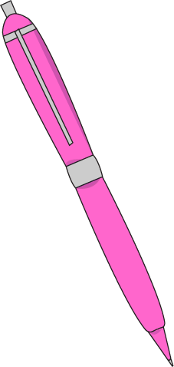
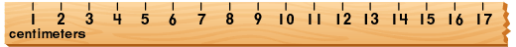
Daily Review
When measuring with a ruler, you just need to remember two simple rules:
always start from zero, and
only use the closest line: don’t guess!
Which of the two examples below shows the pen being measured correctly? Why?
10.7 cm
1.
centimetres
9.0 cm
2.
centimetres

Slide 2
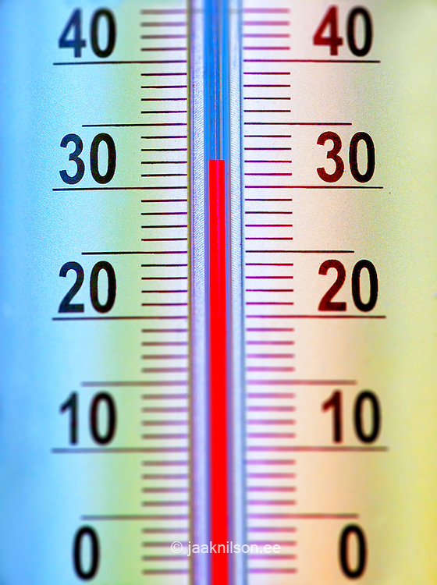

Daily Review
Thermometers
When measuring with a thermometer, there are also two simple rules:
always read the thermometer at eye level, and
only use the closest line: don’t guess!
A student sat at her desk and read a thermometer on the wall. She read the temperature to be 34ºC.
Is she correct? Why?

Slide 3
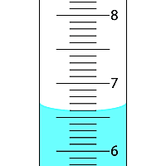
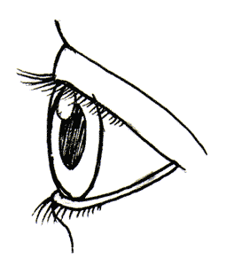
Daily Review
Measuring Cylinders
When measuring with a measuring cylinder, there are another two simple rules:
always read the measuring cylinder at eye level, and
only use the closest line to the bottom of the meniscus.
Which eye is reading the volume correctly? Explain your answer.
C
A
B
A
B

Slide 4
Daily Review
Balances
When measuring with a balance, there are two simple rules:
always make sure that the balance is flat, and
always press the Zero button before adding what you want to weigh.
Put the steps for using an electronic balance in the correct order on your whiteboards.
Press the zero button
Place the empty container on the balance
Add the substance to the container
Place the balance on a flat surface

Slide 5
Observation and Inference Year 7 Science

Slide 6
Learning Objective
CFU
What are we going to learn?
Identify observations and inferences.
Write inferences of observations.
Activate Prior Knowledge
On your white board, draw what comes next.
?
?

Slide 7
Concept Development
CFU 1
How is an inference different to an observation?
Scientists need to be skilled at inference as well as observation.
CFU 2
Which of the following is the observation and which is the inference? The water was boiled recently The temperature of the water was 90°C
An inference is a likely explanation of an observation. It is the process of drawing a conclusion from your observation.
Example:
Observation: Your house smells like cooked onions when you get home from school.
Inference: You are having cooked onions in your dinner.
Vocabulary
Observation: a statement of fact using numbers or descriptions Inference: an explanation of an observation

Slide 8
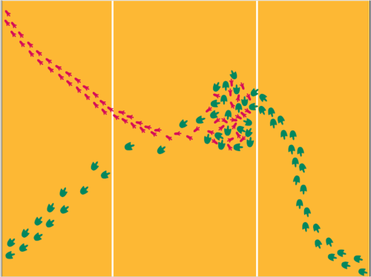
Skill Development/Guided Practice
Scientists need to be skilled at inference as well as observation. An inference is a likely explanation of an observation. It is how you explain your observation.
We will now look at some observation and inferences.
Observation | Inference
There are two sets of footprints
Vocabulary
Observation: a statement of fact using numbers or descriptions Inference: an explanation of an observation

Slide 9
Skill Development/Guided Practice
Scientists need to be skilled at inference as well as observation. An inference is a likely explanation of an observation. It is how you explain your observation.
We will now look at some observation and inferences.
Observation | Inference
There are two sets of footprints | There are two animals
Vocabulary
Observation: a statement of fact using numbers or descriptions Inference: an explanation of an observation

Slide 10
Skill Development/Guided Practice
Scientists need to be skilled at inference as well as observation. An inference is a likely explanation of an observation. It is how you explain your observation.
We will now look at some observation and inferences.
Observation | Inference
There are two sets of footprints | There are two animals
One set of footprints is larger than the other
Vocabulary
Observation: a statement of fact using numbers or descriptions Inference: an explanation of an observation

Slide 11
Skill Development/Guided Practice
Scientists need to be skilled at inference as well as observation. An inference is a likely explanation of an observation. It is how you explain your observation.
We will now look at some observation and inferences.
Observation | Inference
There are two sets of footprints | There are two animals
One set of footprints is larger than the other | One animal is larger than the other
Vocabulary
Observation: a statement of fact using numbers or descriptions Inference: an explanation of an observation

Slide 12
Skill Development/Guided Practice
Scientists need to be skilled at inference as well as observation. An inference is a likely explanation of an observation. It is how you explain your observation.
We will now look at some observation and inferences.
Observation | Inference
There are two sets of footprints | There are two animals
One set of footprints is larger than the other | One animal is larger than the other
The footprints are mixed up together
CFU
What is an inference you can make from this observation?
Vocabulary
Observation: a statement of fact using numbers or descriptions Inference: an explanation of an observation

Slide 13
Skill Development/Guided Practice
Scientists need to be skilled at inference as well as observation. An inference is a likely explanation of an observation. It is how you explain your observation.
We will now look at some observation and inferences.
CFU 1
What is an observation you can make about the image?
Observation | Inference
There are two sets of footprints | There are two animals
One set of footprints is larger than the other | One animal is larger than the other
The footprints are mixed up together | The big animal is chasing the little animal
CFU 2
What is an inference you can make from this observation?
Vocabulary
Observation: a statement of fact using numbers or descriptions Inference: an explanation of an observation

Slide 14
Skill Development/Guided Practice
Scientists need to be skilled at inference as well as observation. An inference is a likely explanation of an observation. It is how you explain your observation.
We will now look at some observation and inferences.
Observation | Inference
There are two sets of footprints | There are two animals
One set of footprints is larger than the other | One animal is larger than the other
The footprints are mixed up together | The big animal is chasing the little animal
There is one set of footprints | The big animal ate the little animal
Vocabulary
Observation: a statement of fact using numbers or descriptions Inference: an explanation of an observation

Slide 15
Relevance
Scientists need to be skilled at inference as well as observation. An inference is a likely explanation of an observation. It is how you explain your observation.
Understanding the difference between observation and inference will help you identify explanations for the observations you make in your experiments.

Slide 16
Skill Closure
Which of the following is an inference? Give a reason why.
You hear your house fire alarm ringing.
Someone has burnt some toast.
Skill Closure
On your white board, write an inference for the following observation.
The herd of cows ran through the paddock.
Vocabulary
Observation: a statement of fact using numbers or descriptions Inference: an explanation of an observation

Slide 17
Independent Practice
Complete the worksheet provided, either on connect or paper copy.
Vocabulary
Observation: a statement of fact using numbers or descriptions Inference: an explanation of an observation

